Slide 1
DRY

Slide 2
OUTRIGHT FRAMEWORK
Outline
Notes on UI Automation
Motivation
Structure
Function
Tool Box

Slide 3
Notes on UI Automation

Slide 4
T
E
S
T
PRECISION
Authenticity
Precision
Compilation
Failures
Assertion
Failures
Errors
seek.com.au

Slide 5
C
HARACTERISTICS

Slide 6
C
HARACTERISTICS

Slide 7
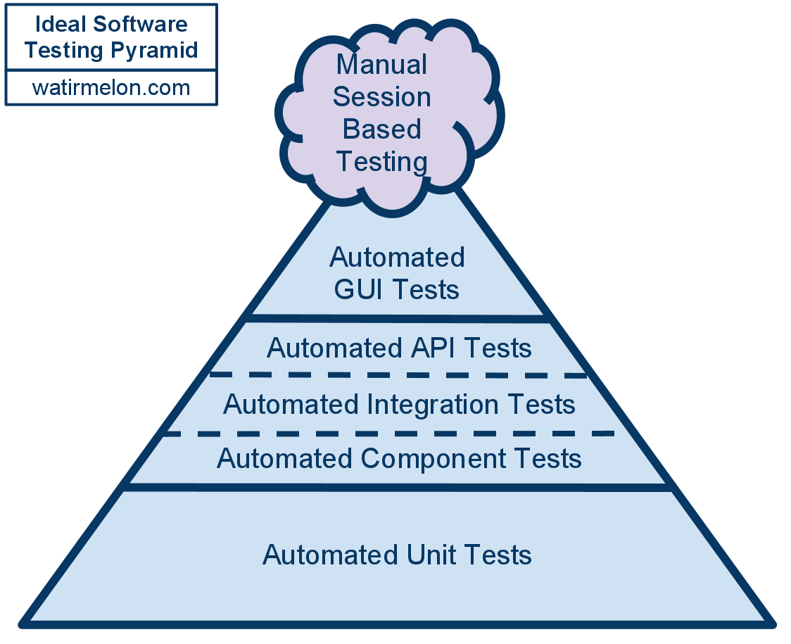
Functional Test Pyramid
C
HARACTERISTICS
Test Automation Basics – Levels, Pyramids & Quadrants

Slide 8
Quiz
What is the most successful software design pattern
of all time?

Slide 9
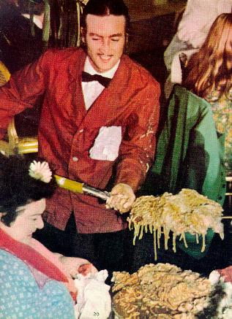
The Most Successful Software Pattern
of all Time
BIG BALL
OF
MUD
Big Ball of Mud Design Pattern
Notes:
Provides a another layer of control
Conditions Apply
UI Automation must be owned by QA
Particularly Useful When:
Development is of low quality
A poorly factored (legacy) code base is under development
Cross cutting concerns are under development
There is churn in the development team

Slide 10
Testing the BBM
BIG BALL
OF
MUD
Automated
Architecturally Constrained
Notes:
Provides a another layer of control
Conditions Apply
UI Automation must be owned by QA
Particularly Useful When:
Development is of low quality
A poorly factored (legacy) code base is under development
Cross cutting concerns are under development
There is churn in the development team

Slide 11
Separation of Concerns
C
HARACTERISTICS
Artefact
Development
+ Low Level
Tests
*
UI Automation
Tests
* Conditions Apply
Notes:
Provides a another layer of control
Conditions Apply
UI Automation must be owned by QA
Particularly Useful When:
Development is of low quality
A poorly factored (legacy) code base is under development
Cross cutting concerns are under development
There is churn in the development team

Slide 12
UI Automation Key Points
C
HARACTERISTICS
Is magnitudes faster than manual testing and can surface defects sooner because they can be run nightly
Is not constrained by the quality / architecture of the AUT
Is more likely to surface defects in the AUT that are incidental to the feature being targeted by the test
If owned by QA proved a valuable control outside development
Is not a replacement for QA domain knowledge and intuition
Is more difficult to maintain and run, slower and more prone to Type 2 than low level tests

Slide 13
Motivation

Slide 14
DRY

Slide 15
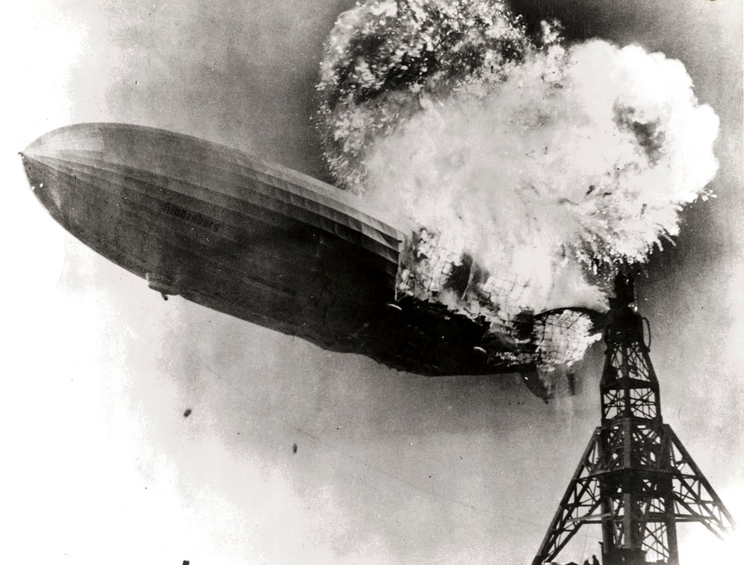
AUTOMATION ROCKS
What Could Possibly Go Wrong ?

Slide 16
Automation == Software Development
ANTIPATTERNS
The magic tool
The opaque facade
Record and playback
Self taught QAs
The seconded Dev
The vanishing consultant
Starting from scratch
Automate everything
Automate tours
Integrate everything
DevOps not done
e.g. roll over
Lack of ownership
Death by fagile

Slide 17
Consequences
ANTIPATTERNS
=> NOT DRY && NOT UNDERSTOOD
=> EXCESSIVELY PRONE TO TYPE 2 ERRORS
=> UNMAINTAINABLE
=> NOT MAINTAINED

Slide 18
Why Zenith?
OUTRIGHT FRAMEWORK
Keep the code base
small
understandable
understood
testable
maintainable
and it is ready now
H0: UI Automation is Snake Oil

Slide 19
STRUCTURE

Slide 20
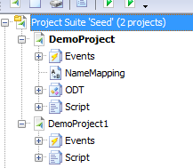
PROJECT STRUCTURE
Project Suite
Corresponds to an application under test
May also be used to isolate a single project (for IDE performance)
Project
Can be an arbitrary collection of tests or correspond to a functional area
Having multiple projects can improve IDE performance on very large test suites
Contains all the test items such as scripts and name mappings
Project items can be shared between projects

Slide 21
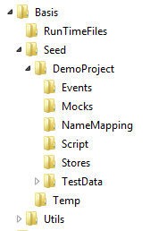
FILE STRUCTURE
Suite Folder
Project Folder
Project Items
Test Data
Shared Functions

Slide 22
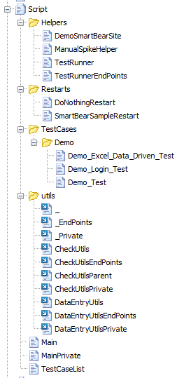
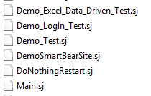
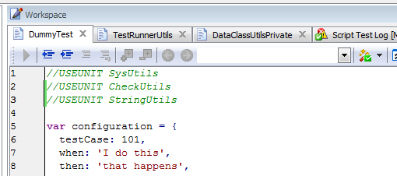
TestComplete - Project View
Files
SCRIPT
UNITS
Uses Clause
TestComplete – Script Editor

Slide 23
UNIT STRUCTURE
Utils (Generic Functions)
DateUtils
SysUtils
StringUtils
FileUtils
WebUtils
Main
TestList

Slide 24
UNIT STRUCTURE
Utils (Generic Functions)
DateUtils
SysUtils
StringUtils
FileUtils
WebUtils
Test Cases
TimeCostTest
SalaryTest
InventoryTest
InventoryTest
Main
TestList

Slide 25
UNIT STRUCTURE
Utils (Generic Functions)
DateUtils
SysUtils
StringUtils
FileUtils
WebUtils
Helpers
TimeCost
StaffInfo
Salary
Test Cases
TimeCostTest
SalaryTest
InventoryTest
InventoryTest
Main
TestList

Slide 26
UNIT STRUCTURE
Utils (Generic Functions)
DateUtils
SysUtils
StringUtils
Makes You You
FileUtils
WebUtils
Helpers
TimeCost
StaffInfo
Salary
Test Cases
TimeCostTest
SalaryTest
InventoryTest
InventoryTest
Main
TestList

Slide 27
Utils (Generic Functions)
UNIT STRUCTURE
Are the basis of the framework
Provide generic cross-project / cross-application functions
Can only use other utils
Named <Functional Area><Utils> e.g. StringUtils
Are often wrappers around TestComplete functions
Helpers
Are normally project / application specific
Contains code shared by two or more test cases
Are built up as test cases are refactored
Can use utils or other helpers
Named <Functional Area> e.g. Salary
Test Cases
Application project specific
Can use utils or helpers
Cannot be used by any other unit than TestList
Named <TestSummary>+Test e.g. SalaryCalculationTest

Slide 28
Two Special Units
UNIT STRUCTURE
Main – Defines How Your Project Behaves Differently to Other Projects
Test Run Functions
Test Configurations
Links up test run controlling functions (i.e. Composition Root)
  preAcceptMethod
  restartMethod
  simpleLogProcessingMethod
Test List – Partially Automated List of All Tests that Can Be Run
Contains a list of all test units in the project
Contains restart units
Is validated and updates itself and fails if the list is not valid at the start of the test

Slide 29
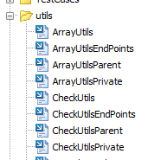
Auxiliary Units
UNIT STRUCTURE
* EndPoints
Occur with Utils and Helpers
Contain UnitTests and Endpoints
Reduce clutter in code completion
Not necessary for TestCases / Priv Units
* Private
Occur with Utils and Helpers
Reduce clutter in code completion
Not necessary for TestCases
* Parent / GrandParent
Use to resolve recursive references in Utils and Helpers

Slide 30
FUNCTION

Slide 31
run
config
Validate / Set Run Config Defaults
start
TE
ST
RUN
Validate / Set Test Config Defaults
test
config
run
config
test
filters
filtered
test list
test
config
test list
test
items
test case
run
config
item
index
test
item

Slide 32
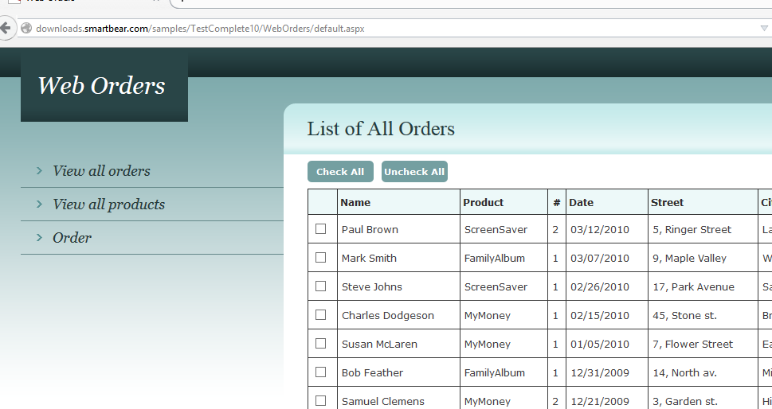
EXECUTION
AUT
Interactor
apState
Validators

Slide 33
EXECUTION
AUT
Interactor
apState
Validators
Mocks

Slide 34
MOCKING
Mocks
Validators
apState

Slide 35
Interactor
apState
Validators
PRE
AUT
function interactor(runConfig, itemIndex, item, apState){
_.defaults(apState, item.apState);
}
function testItems(runConfig){
return [
{
id: 1,
when: 'the correct login credentials are used',
then: 'the user is able to log in',
userName: 'Tester',
password: 'test',
apState: {
url: WEB_ORDERS_DEFAULT_URL(),
'error message': 'N/A'
}
},

Slide 36
TEST
CASE
FUNCTIONS
//USEUNIT TestRunner
//... other units
var TEST_CONFIGURATION = {
id: -2,
when: 'a user attempts to log in',
then: 'access is granted or denied as expected',
owner: 'LLCJ',
demo: true,
enabled: true
};
function testCaseEndPoint(){
var testParams = {
testConfig: TEST_CONFIGURATION,
itemSelector: 1, //topIssue, lastItemWithValidators, all, {otherProp: }
country: AUSTRALIA(),
mocking: false
};
runTestCaseEndPoint(testParams);
}
function interactor(runConfig, itemIndex, item, apState){
logOnWebOrders(item.userName, item.password);
apState.url = activePageUrl();
}
function logged_in_successsfully(apState, item, runConfig){
checkEqual(WEB_ORDERS_DEFAULT_URL(), apState.url);
}
function testItems(runConfig){
return [
{
id: 1,
when: 'the correct login credentials are used',
then: 'the user is able to log in',
userName: 'Tester',
password: 'test',
validation: logged_in_successsfully
}
]
}

Slide 37
TOOLBOX

Slide 38
T
OOL
SOURCES
TestComplete
TestComplete script extensions
Zenith Framework functions
External JS libraries
Native Javascript

Slide 39
DEMO

Slide 40
Favourite Features
Help
  Language filter
Editor
  Code Navigation - unit or function
  Find / Replace
  Bookmarks
  Script search
  Code templates
  <View><Desktop><Restore Default Docking>
Script Development
  Object Spy
  Record / Playback
Debugging
  The log file
  Debugger / debugger windows
T
ESTCOMPLETE

Slide 41
Favourite Features
Help
  Language filter
Editor
  Code Navigation - unit or function
  Find / Replace
  Bookmarks
  Script search
  Code templates
  <View><Desktop><Restore Default Docking>
Script Development
  Object Spy
  Record / Playback
Debugging
  The log file
  Debugger / debugger windows
T
ESTCOMPLETE

Slide 42
T
C
SCRIPT
EXTENSIONS
aq* - TestComplete (initially developed by Automated QA)
  aqDateTime – date time calculations
  aqEnvironment – info about operating system
  aqFileSystem – working with files
  aqFile – read write files complements
  aqConvert – data conversion
  aqString – string functions
  aqObject – reflection
Other Useful Objects
  Log – write to log file (also in utils)
  Indicator – show information in indicator
  Runner – run methods (advanced)

Slide 43
Favourite Features
OUTRIGTH
FRAMEWORK
Generic Features
  TestCaseList & restarts
  Even easier data driven testing
  End points / unit tests
  testCaseEndPoint
  OTB code templates
  API Docs
  simpleLogFileProcessing
Methods
  preAccept
  def
  seek, seekh, seekInPage, seekInPageh
  expectDefect / endDefect
  stringToFile / arrayToFile

Slide 44
EXTERNAL
LIBRARIES
Underscore.js
JSON2

Slide 45
NATIVE
JAVASCRIPT
w3schools
Javascript the Good Parts

